Slide 1
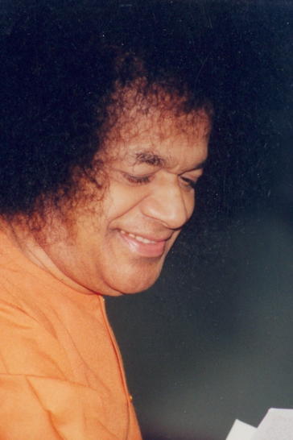
A presentation to the almighty master of all

Slide 2
For you and me
Chapter 16
of
Sathyam Sivam Sundaram

Slide 3
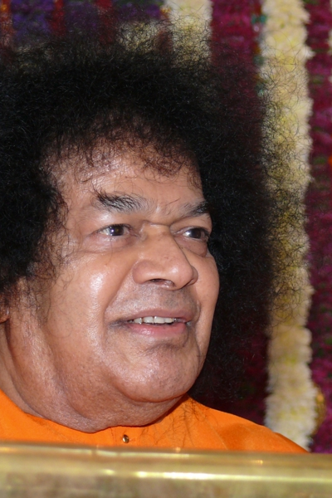
The last Chapter of Sathyam Sivam Sundaram is message to readers of the book by the author.
As we reach the last pages of the book, and this has been written in the year 2009.
The author assures us that there are more chapters to come in this book

Slide 4
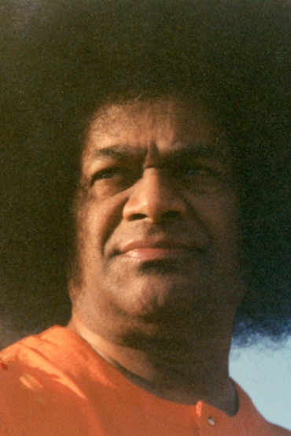
The golden age of human redemption
The golden age of human redemption is here.
Baba says, “I came here, because the good men of the world, the saintly, the wise, the sadhu and the sadhaka, the Guru and godly, panted for me.”

Slide 5
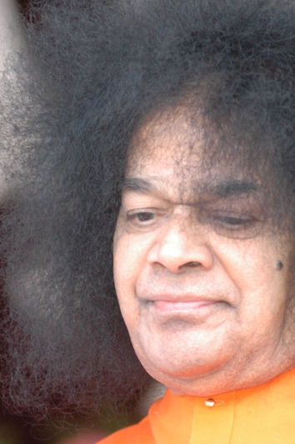
With what offering shall we approach him?
Don’t offer things like patram, pushpam and Phalam.
Offer Sathya, Dharma, Shanthi, Prema or at least the effort attain these four, or any one of the four. Sincerity in the struggle to improve, that is enough

Slide 6
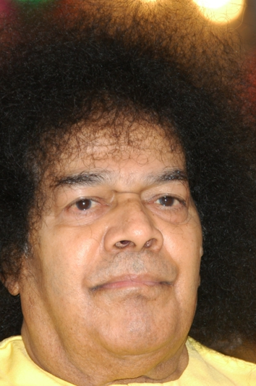
The needed Offerings as per Bhagwan
“Offer in Patram of the body, the Manopushpam fragrant with Humilty, the Hridhayaphalam ripe with Tapas and sweet with the rasam of Daya, Dhanam, and the Toyam of tears welling out of Ananda, That is enough”

Slide 7
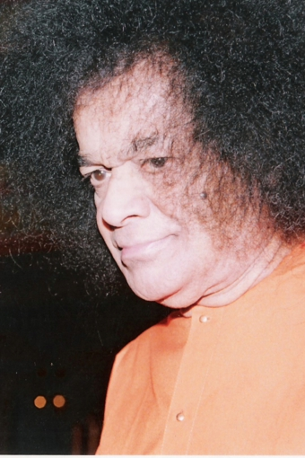
May HE, the Source, the Stream,. And the Sea, the All-pervasive, All-inclusive, All-animating –
SATHYAM-SIVAM-SUNDARAM vouchsafe to us all the strength and the steadfastness, to journey towards HIM

Slide 8
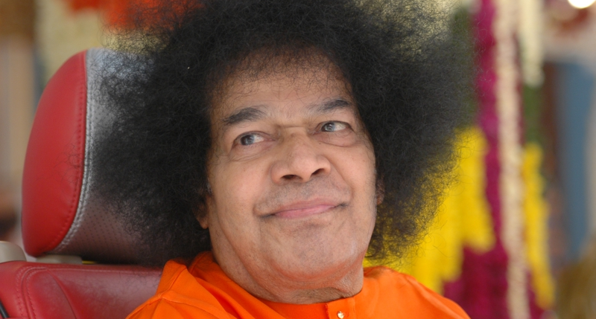
Thank you
JAISAIRAM

